Slide 1


Data Mining on
Home Forestation
Presented By
Presented To
Tanveer Hoque
ID: 153-15-6334
Ms. Zerin Nasrin Tumpa
Lecturer
Department of CSE
Daffodil International University.

Slide 3
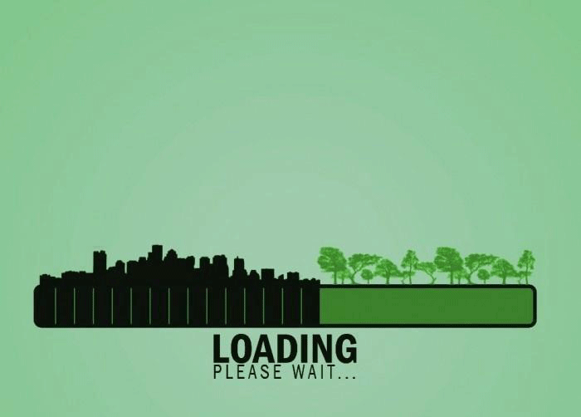
?

Slide 4

“ All Human Beings are in Danger
Because of Deforestation ”

Slide 5

“Death rate in Bangladesh is the highest all over the world due to air pollution”

Slide 6

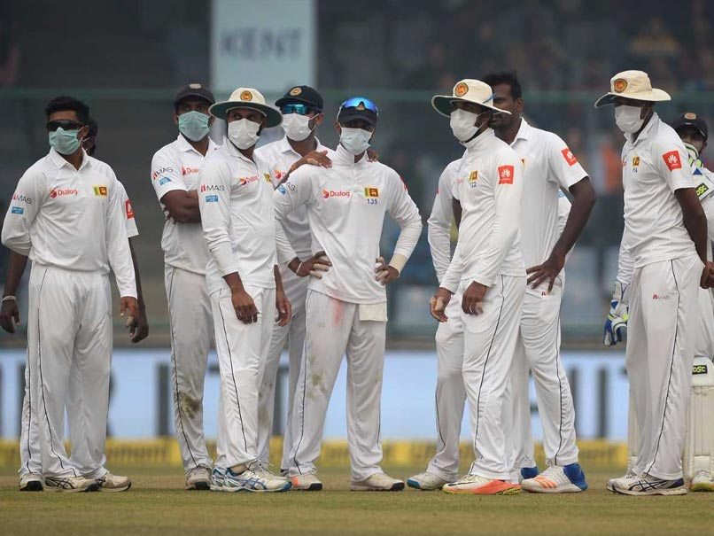
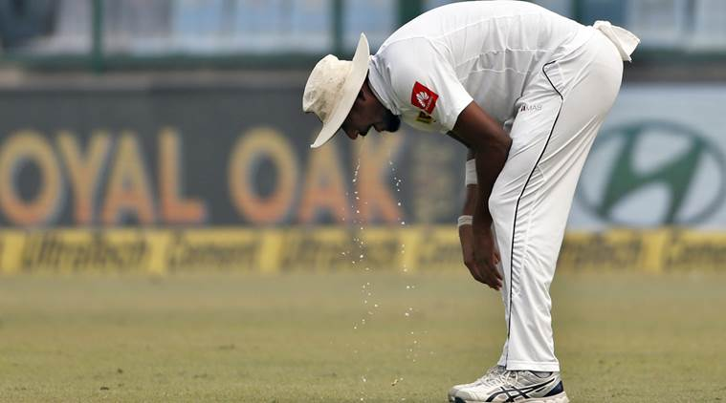

Recent Example

Slide 7
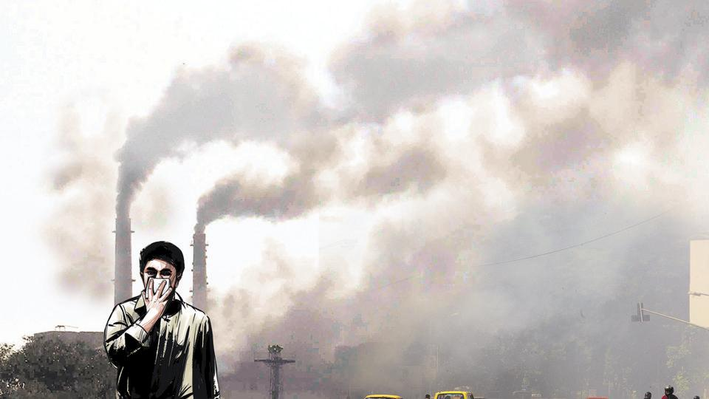

Every 1 out of 8 deaths
in the world is due to
air pollution
(WHO-2014)

Slide 8
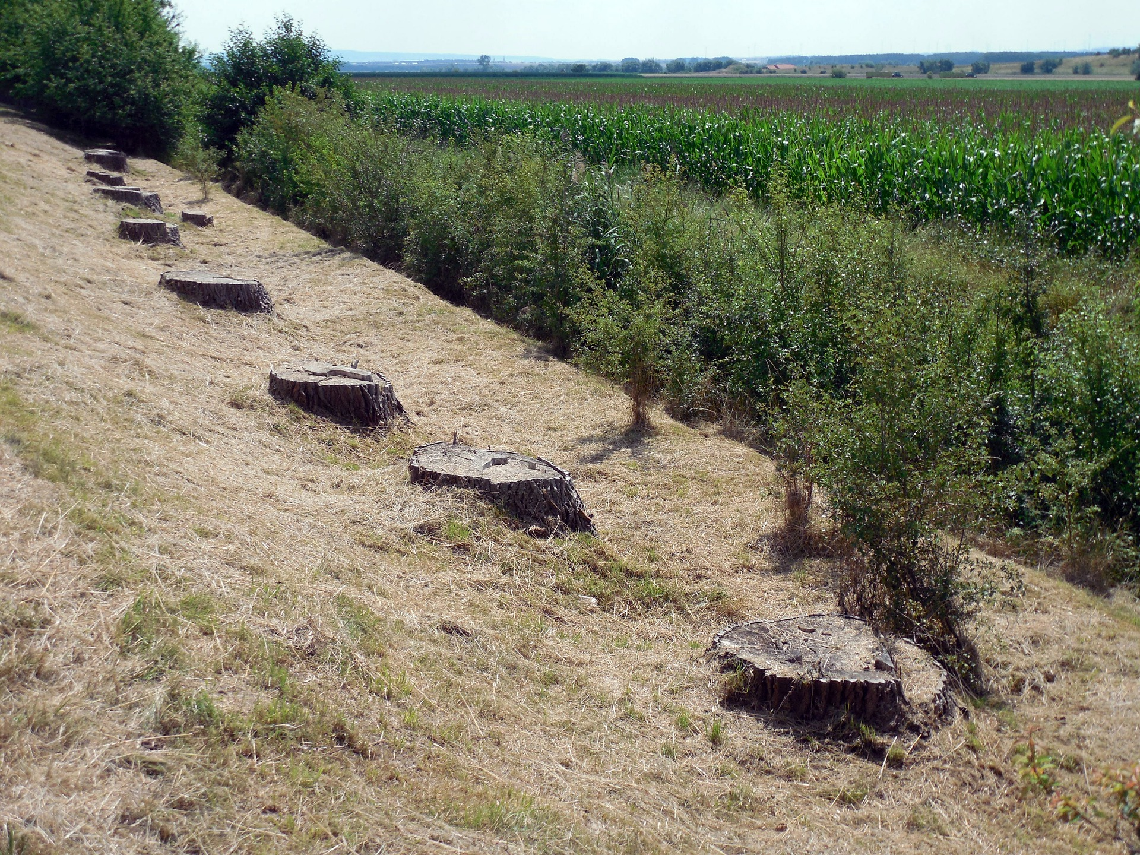
Global Statistics
Almost 50,000 sq. miles of forest lost/year
Amazon lost around 17% of the forest in the last 50 years
Rate of deforestation = 20 football fields/minute.
Estimated that there will be no rainforest within 100 years.

Slide 9
Statistics in Bangladesh
50% forests destroyed in last 20 years
Almost 1.2 lakhs people die per year due to air pollution
8.5 million peoples are attacked by asthma and 7.5 are bronchitis
24% students are facing lungs problem

Slide 10

Where will you plant tree
???

Slide 11


Slide 12

How Eco friend Works

Slide 13


Slide 14


